Slide 1


Form16 Digital Signature validation
Payroll Team

Slide 2
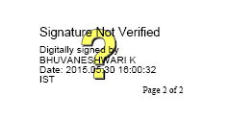
Form16 Certification signature need to be changed by clicking on Digital Signature below
Click on Digital Signature from your Form16

Slide 3
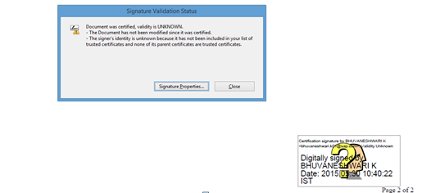
Select Signature properties radio button

Slide 4
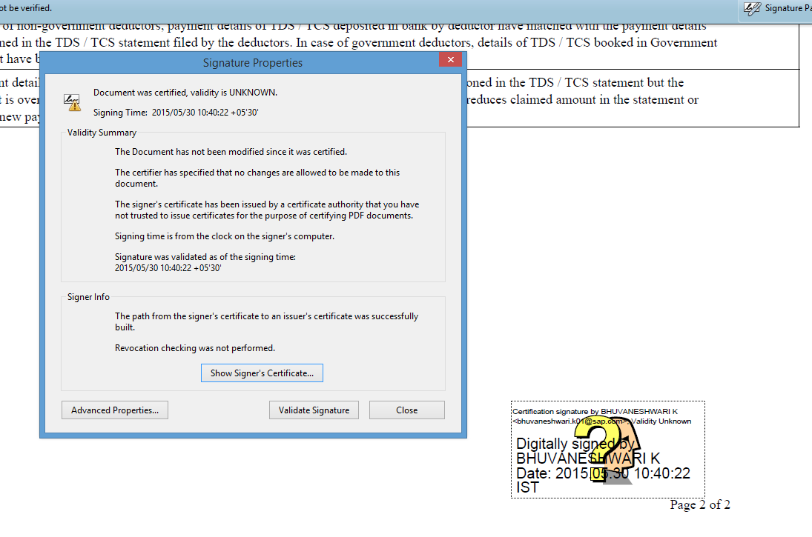
Select Show Certificate radio button
Click on show signer’s certificate.

Slide 5
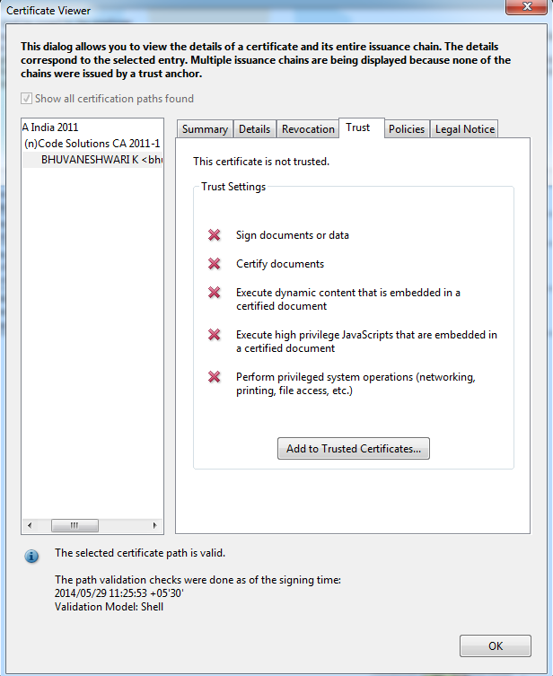
Select Trust menu
Click on Trust Menu

Slide 6
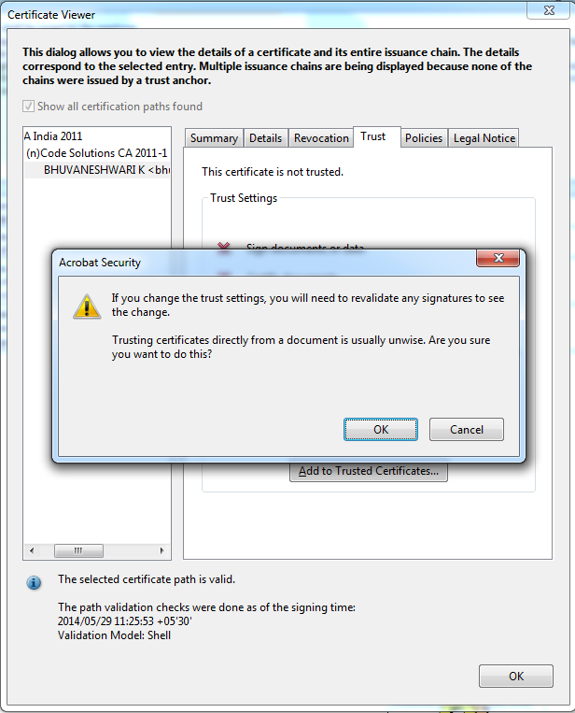
Select Add to Trusted Identities radio button & click ok
Click on ok

Slide 7
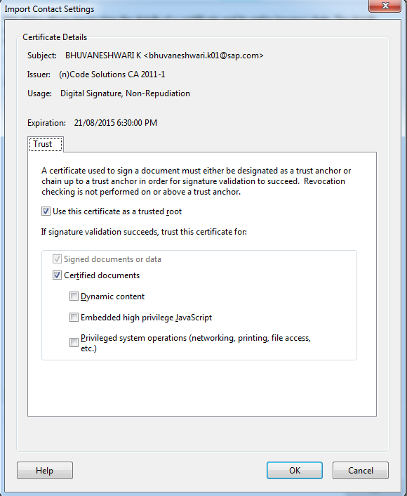
Import contact setting click ok radio button
Click on ok

Slide 8
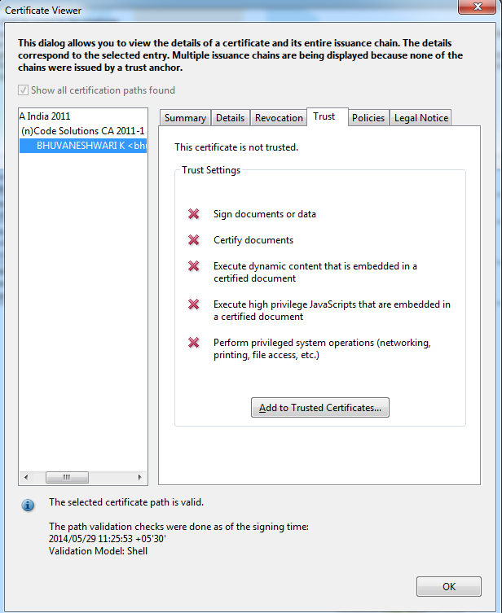
Certificate Viewer click ok radio button
Click on ok

Slide 9
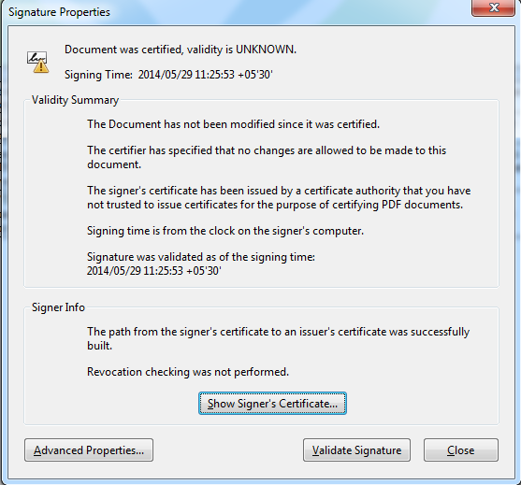
Signature Properties click Validate Signature radio button
Click on Validate Signature

Slide 10
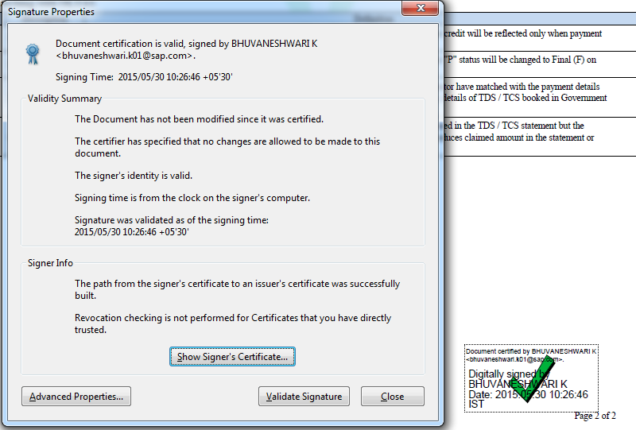
Finally Digital Signature will get Validated

Slide 11
Thank You!
E-mail – hrdirectapj@sap.com
Phone – Bangalore: 7138

